Slide 1





KS2 SATs Information for Parents
Meanwood CE Primary School
Open Hearts
Open Minds
Open Arms

Slide 2





Introduction
KS2 SATs assess Year 6 pupils' English and Mathematics skills.
Results identify strengths, guide improvements, and provide data for secondary schools and reporting.
Overview of test timetable, paper details, question types, and support for parents during SATs week.
Open Hearts
Open Minds
Open Arms

Slide 3
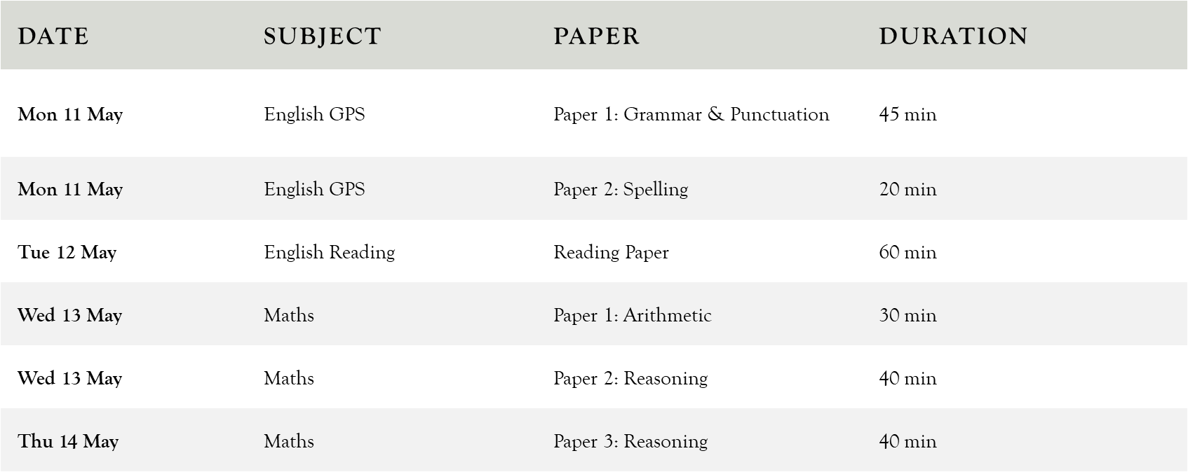
When and What Tests Will Take Place
Open Hearts
Open Minds
Open Arms

Slide 4

GPS (Grammar, Spelling and Punctuation).
Paper 1: Grammar and Punctuation
Paper 1 lasts 45 minutes and tests grammar, punctuation, sentence corrections, and word class identification.
Paper 2: Spelling Test
Paper 2 is a 20-minute spelling test where pupils write 20 dictated words in context.
Topics include sentence structure, clauses, punctuation marks, verb tenses, and correct application of language rules.
Open Hearts
Open Minds
Open Arms

Slide 5
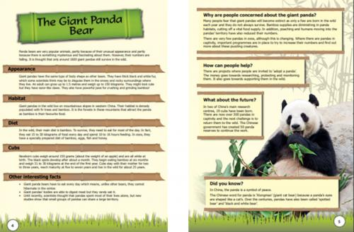
Reading
The reading test lasts 60 minutes with 50 marks, covering three texts from fiction, non-fiction, and poetry genres.
Questions assess retrieval, inference, vocabulary, summarising, and comparing skills to evaluate comprehension.
Pupils must manage time effectively to read passages and answer questions such as finding words and explaining author choices.
The test ensures pupils interpret and analyse texts, promoting critical thinking and deep understanding of materials.
Open Hearts
Open Minds
Open Arms

Slide 6

Maths
Paper 1: Arithmetic
Paper 1 focuses on arithmetic calculations like addition, subtraction, multiplication, division, fractions, decimals, and percentages within 30 minutes.
Papers 2 and 3: Reasoning
Papers 2 and 3 test problem-solving skills through multi-step reasoning and real-life application questions, each lasting 40 minutes.
The papers aim to assess fluency in calculations, reasoning abilities, and problem-solving skills in mathematics.
Open Hearts
Open Minds
Open Arms

Slide 7

After the tests…
Papers externally marked; results available from Tuesday 7 July 2026.
Scaled score between 100 and 109 = expected standard.
Scaled score between 110 and 120 = working above the expected standard.
Below 100 indicates working towards the expected standard.
Teacher assessments issued for Writing and Science
Open Hearts
Open Minds
Open Arms

Slide 8
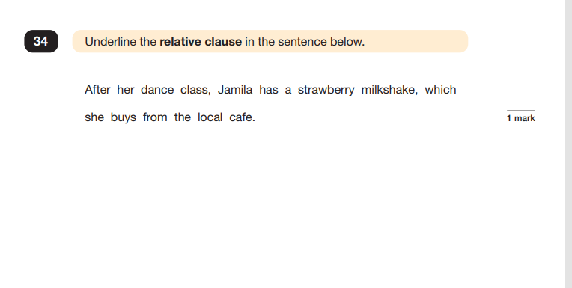
Example question… GPS
Open Hearts
Open Minds
Open Arms

Slide 9
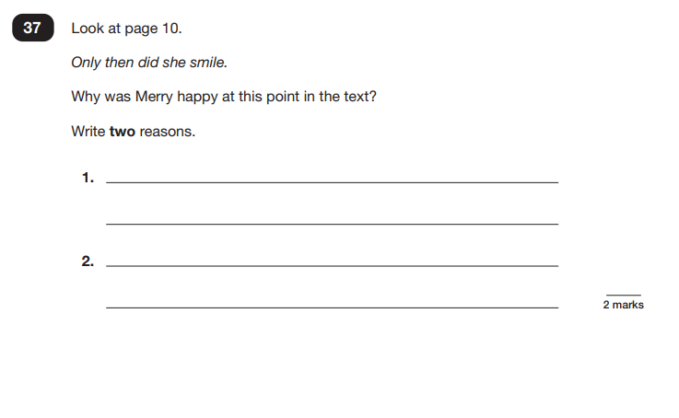
Example question… Reading
Open Hearts
Open Minds
Open Arms

Slide 10
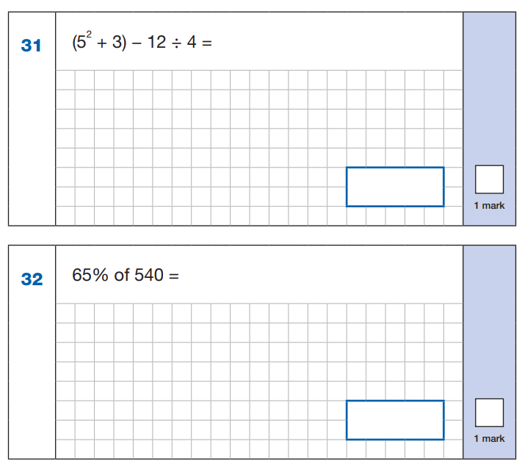
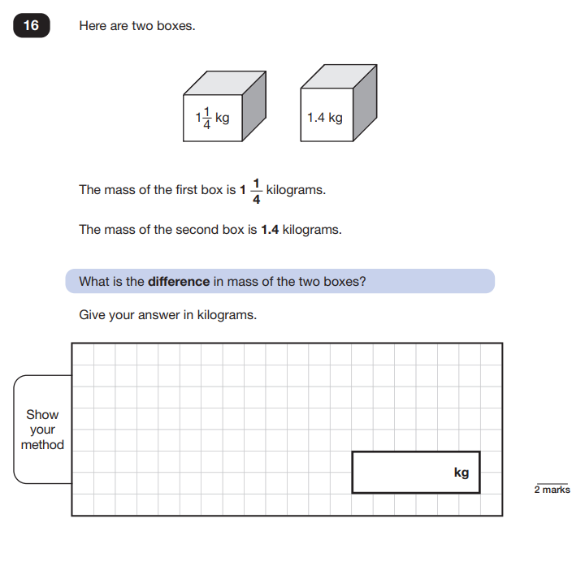
Example question… Maths
Open Hearts
Open Minds
Open Arms

Slide 11

What can I do…
Support with homework; CGP books.
Reassure.
Open Hearts
Open Minds
Open Arms

