Slide 1

Family Evening Workshop Presentation Wednesday 11th March 2026

Slide 2
Presentation
Letter formation, including pencil grip
Handwriting progression across school
Presentation pledges

Slide 3
Presentation
At Meanwood C of E Primary, we want our children to take great pride in all their written work. Our aim is that pupils will be supported to develop a handwriting style which is clear, joined and fluid. Inevitably some will be neater than others, but each child can acquire a consistent and fluent style. Although there are many opportunities to practise handwriting across the curriculum, we also provide regular lessons for teaching and revising these skills. The frequency and length of these lessons will vary according to the age and competence of the children.
Letter formation is taught in Reception using FFT using writing cues. Formal handwriting skills will be taught regularly and systematically through the use of the PENPALS Handwriting scheme (Cambridge University Press). We also have presentation pledges for all written work and mathematics work.

Slide 4
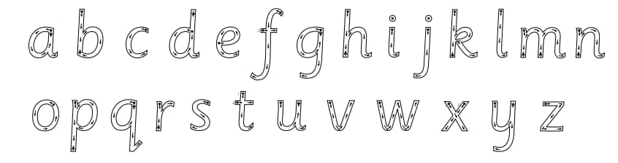
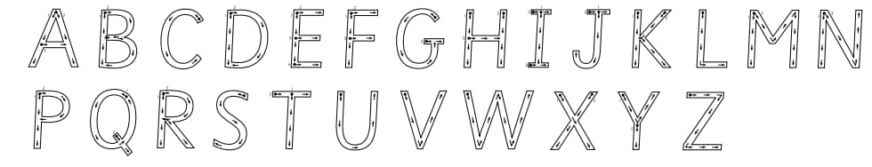
Correct letter formation

Slide 5
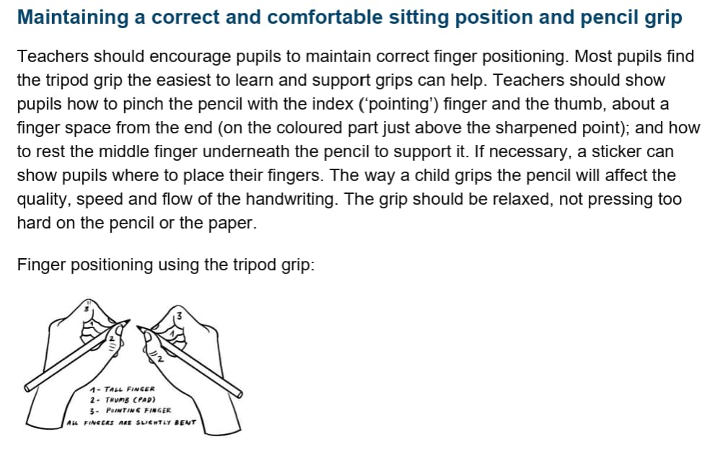
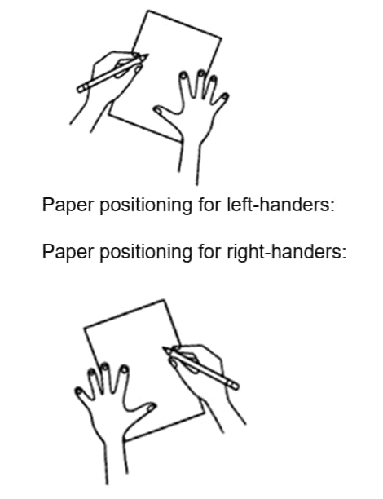
Correct pencil grip

Slide 6
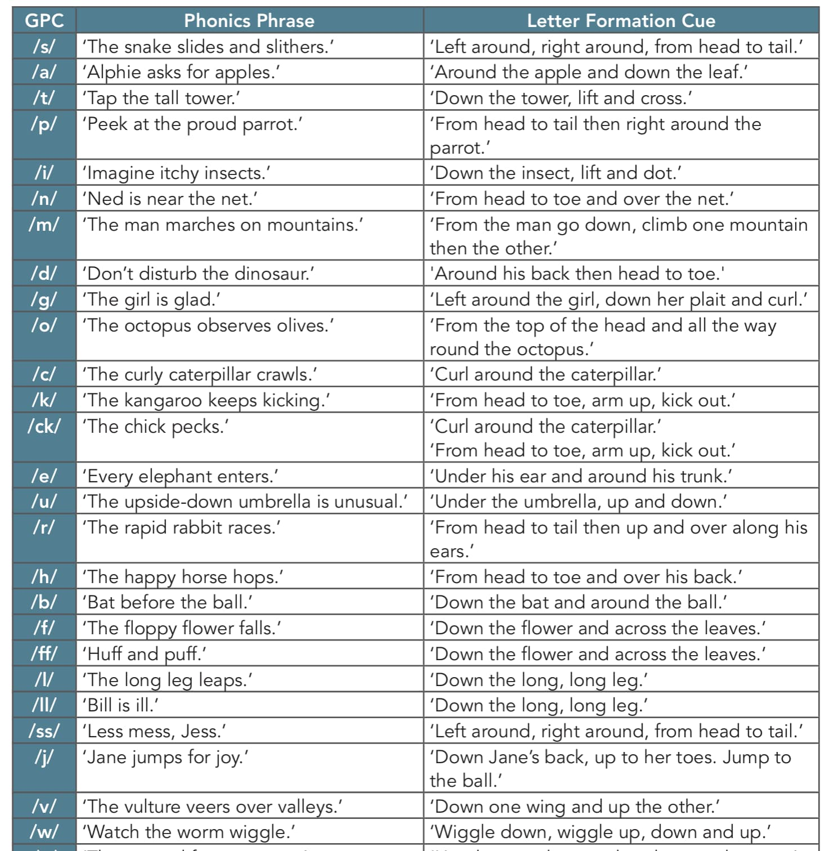
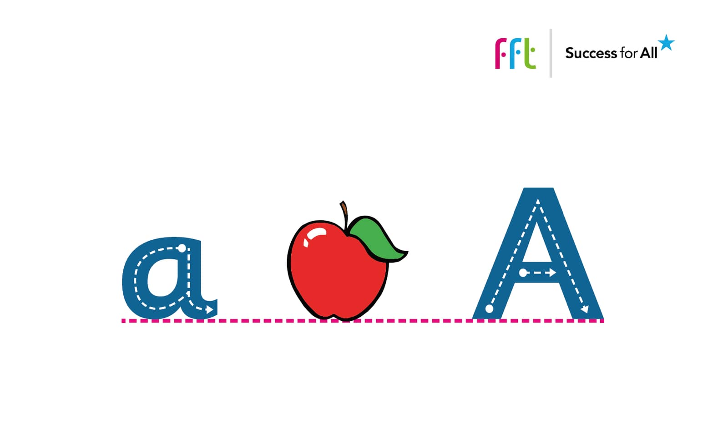
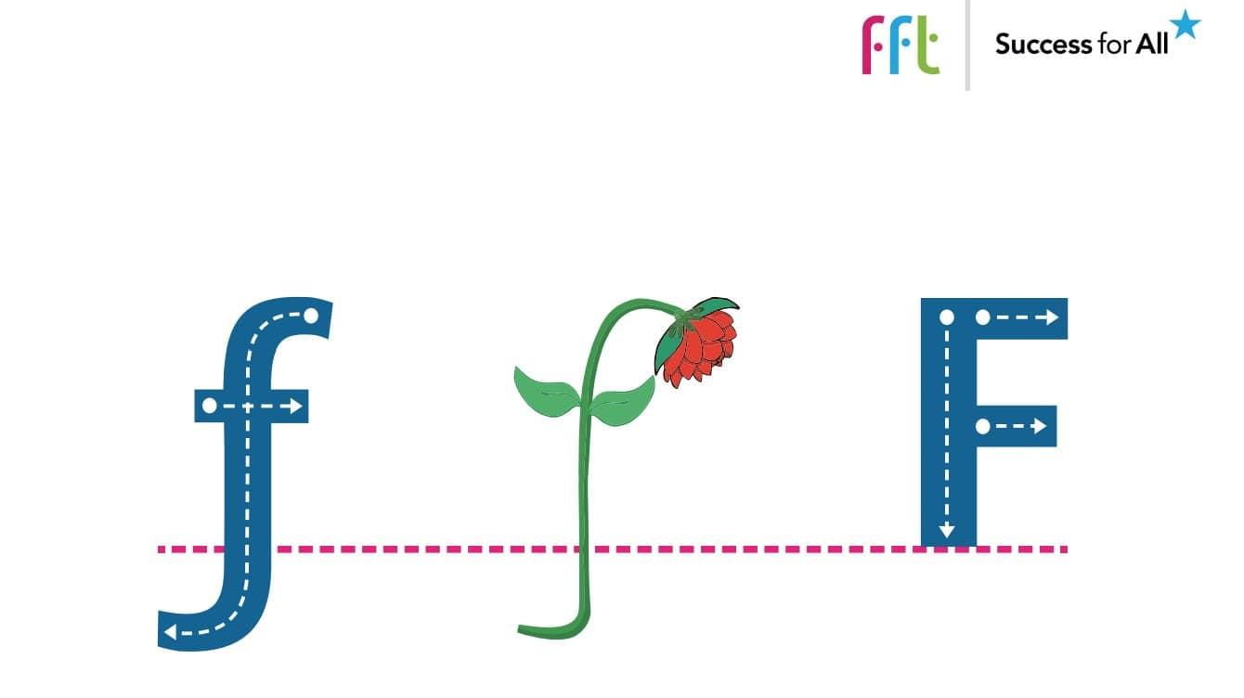
FFT SfA: Alliterative phrases and letter writing cues

Slide 7
Handwriting
Penpals for Handwriting is a complete handwriting scheme for 3–11 year olds, offering clear progression through five developmental stages. It teaches children a fast and fluent handwriting style to help them achieve their potential in writing.
Penpals uses a combination of interactive digital resources for whole-class teaching and practice books and write-in workbooks for small group and individual work.
Practise books and workbook provide essential practise and reinforcement.
Sky-writing and lesson warm-ups develop the fine and gross motor skills that are crucial for handwriting.
In Years 5 and 6 basic handwriting issues are revised and speed and fluency improved.

Slide 8
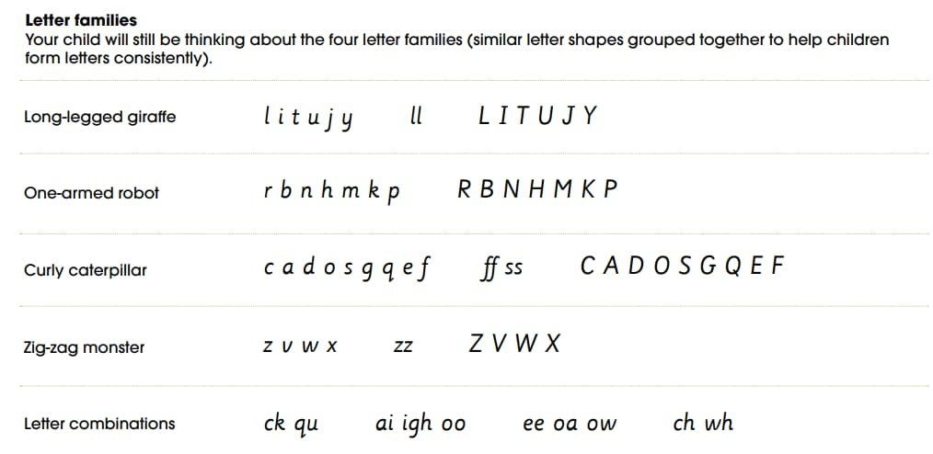
Letter families
Reception

Slide 9
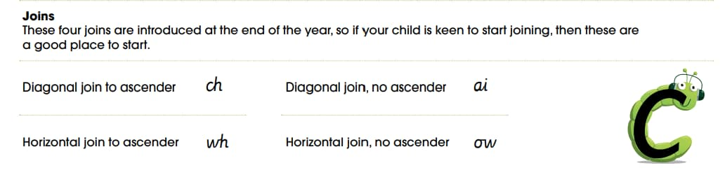
First joins
Year 1

Slide 10
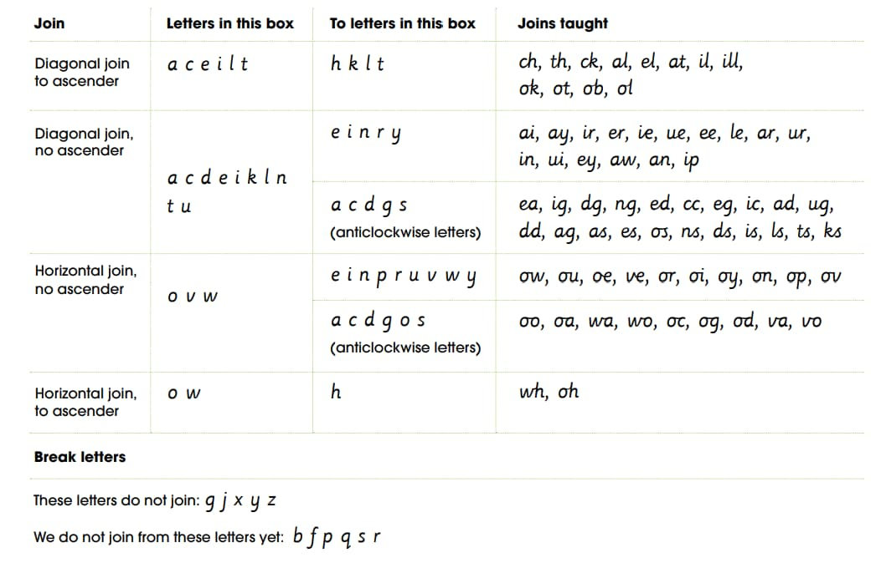
Expectation by the end of Y2, children are joining up
Year 2

Slide 11
During Years 3 and 4, your child will be introduced to the idea of joining most of the letters in a word and to trickier joins such as joining from r, s and f. As the movement for joins becomes more familiar and fluent, the focus moves to develop a neat and even style by looking at size and proportion, parallel downwards strokes and spacing.
KS2 progression in handwriting
In Year 5 we are working on a more sloped style to enable speedier writing. All of the letters and joins taught previously will be revisited to enable your child to practise the slope in familiar contexts. We will also focus on issues of proportion, size, legibility and different styles for different purposes
Our emphasis in Year 6 is on developing a personal, fast, fluent and legible handwriting style. Children are given opportunities to practise a range of ways of joining, with the expectation that they will develop a style that ‘works’ for them. Additionally, children continue to focus on key issues for legibility and speed as well as styles and writing tools for different purposes.

Slide 12
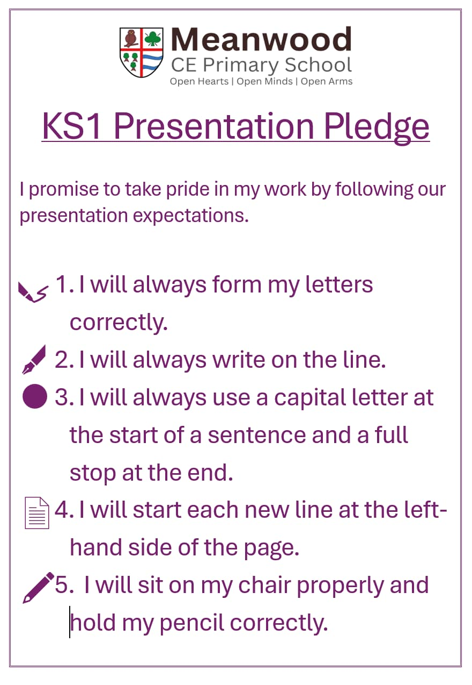
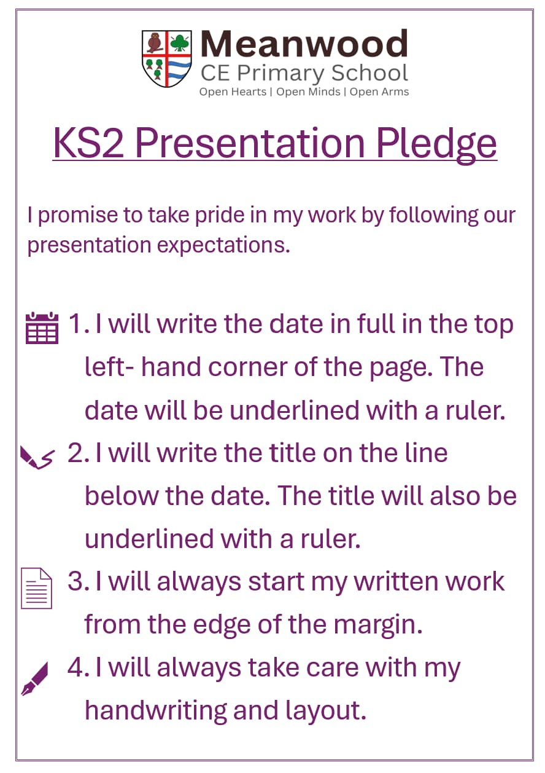
Presentation Pledges

