Slide 1

Parental/carer engagement in Maths in EYFS
Meanwood C of E Primary School

Slide 2
Agenda
Cardinality and counting
Comparison
Composition
Practical – activities to support number at home

Slide 3
Why does it matter?
‘A significant positive correlation between children’s early mathematical knowledge and skills and later achievement in mathematics. Specifically, children who demonstrated higher levels of mathematical competencies during their early years exhibited greater success in later academic performance.'
Chen, W. Problem-Solving Skills, Memory Power, and Early Childhood Mathematics: Understanding the Significance of the Early Childhood Mathematics in an Individual’s Life. J Knowl Econ 16, 1–25 (2025).

Slide 4
6 big ideas
Cardinality and counting
Composition
Comparision
Shape and Space
Measures
Pattern
Notes:
Focus on cardinality and counting today

Slide 5
Subitising
Perceptual subitising
Recognising a quantity without using other mathematical processes
Conceptual subitising
Recognising the number pattern as a composite of parts and whole
Notes:
Explain that there are 2 aspects in subitising – as above
Perceptual subitizing up to 5 (this is still be debated some will say 4)

Slide 6

Perceptual subitising
Notes:
Recognising on sight without counting - each image will appear on first click and disappear on second click
Typically we can subitise up to 5 items (adults) without other mathematical processes
This is perceptual subitising
Familiar spatial patterns/arrangements may help with this e.g. dice dot arrangements (or arrangements very similar to familiar arrangements)

Slide 7

Conceptual subitising
Notes:
Each image will appear on first click and disappear on second click
Discuss how the quantities are perceived (4 and 3, 5 and 2, 2 and 2 and 3, etc) and whether the quantities can be determined without counting
Recognising on sight without counting but using understanding of composition - part/whole relations (sometimes this is almost instantaneous)
Typically can subitise smaller quanities within the whole group and use other mathematical processes to form knowledge of the quantity in the whole group
This is conceptual subitising

Slide 8

Counting: a deceptively simple skill
Many people consider counting to be a simple skill, but that leads us to be deceived – we often hear young children recite a string of words and assume they can count. (Penny Munn 1977)
Notes:
Always emphasize the how many
1,2,3,4,5 5 cars not just “doing the counting thing”

Slide 9
Aspects of counting
Verbal counting (intransitive)
recitation - the ability to say the words
Object counting (transitive)
enumeration – the ability to count objects
Notes:
Intransitive counting (intransitive verb is an action) – “I count” (same as I arrive, I sit, I sleep), it is something I do = saying the counting words
Transitive counting (transitive verb is an action on an object) – “I count something” (e.g. I count cars, I count beeps, I count ideas), it is something I do to something else = using number words for quantities

Slide 10
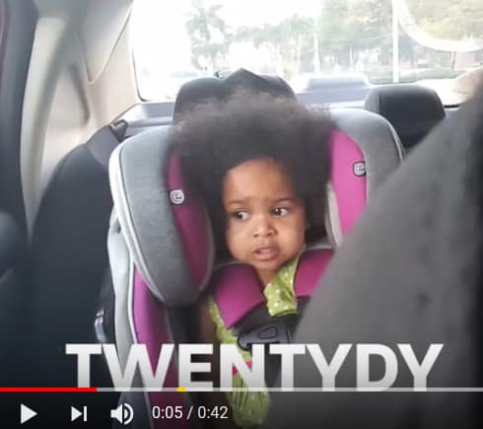
Verbal counting
https://www.youtube.com/watch?v=JPeHv1CKF94
Notes:
Example
Click on image to get hyperlink to: https://www.youtube.com/watch?v=JPeHv1CKF94
Child is verbal counting. Focus on what she ‘can do’ in counting. Pattern to her counting.

Slide 11
Developing counting skills:
Gelman and Gallistel’s counting principles
stable-order principle
one to one principle
cardinal principle
abstraction principle
order irrelevance principle
Notes:
Introduce counting principles. They may be familiar to many participants.
Taken from:
http://interactivestem.org/wp-content/uploads/2015/09/Interactive-STEM-Brief-Counting-and-Cardinality-Sept-16-Final-File.pdf
Gelman and Gallistel (1978) outline five principles for counting that require children to coordinate their knowledge across
all three of these big ideas and to generalize them across different counting situations. Proficient counters must be able to
do the following:
1. Consistently use the number words in the same order (stable order principle)
2. Count every item in a set only once, using only one number word (one-one principle)
3. Understand that the last number word used represents the cardinality of the set (cardinal principle)
4. Recognize that any collection of like or unlike items can be counted as a set (abstraction principle)
5. Understand that the result is the same no matter the order in which the objects are counted (order irrelevance principle)

Slide 12
Counting Principles
Children have to learn how to do a number of things consistently in order to count successfully. These are the counting principles.
Stable order
The stable order principle refers to the understanding that numbers must always be said in the same order, i.e. 1, 2, 3, 4, 5 and not 1, 3, 2, 5, 4.
Children count spontaneously from an early age, often saying the numbers in the wrong order. Collaborative play with an adult or older child helps them to develop stable order counting. Counting things aloud and making deliberate mistakes is highly effective in helping children to learn the correct counting order.

Slide 13

Stable order principle
https://www.youtube.com/watch?v=ZtUPKekDY7M
Notes:
Click on image to hyperlink to https://www.youtube.com/watch?v=ZtUPKekDY7M
https://thegorseacademiestrust.sharepoint.com/sites/TrustDrive/Creative%20Area/Video%20Library/Forms/AllItems.aspx?csf=1&e=qvkeXC&CT=1598866463930&OR=OWA%2DNT&CID=43beab0b%2D595c%2D6ae4%2Dddf7%2D56e91b5c7c46&RootFolder=%2Fsites%2FTrustDrive%2FCreative%20Area%2FVideo%20Library%2FRA%2FEY%20Maths%2DCounting&FolderCTID=0x0120006440D1965D0EA948ACB36ED957E82335

Slide 14
Counting Principles
One-to-one correspondence (tagging)
One-to-one correspondence refers to the ability to match one object to one number consistently. Without this skill, children will not be able to understand how many objects are in a group (the cardinal value).

Slide 15
Counting Principles
Cardinality
Understanding the cardinality principle means that a child appreciates that the last number counted indicates how many things are in the set.
Notes:
Cardinality – there is a potential danger of continually reinforcing just this aspect of number i.e. just showing numbers as a set of objects. Also are we explicit about cardiniality.
Add to this order and arrangement of the objects is irrelevant
Then
Matching the names to numerals
Connecting one more and the next number- Haylock

Slide 16
Counting Principles
Abstraction
As children become more competent at counting, they begin to understand the abstract nature of number. They can count 5 apples, 5 assorted things from their pocket and even things they cannot see such as 5 steps up to their house or 5 bangs on a drum.
Notes:
Cardinality – there is a potential danger of continually reinforcing just this aspect of number i.e. just showing numbers as a set of objects. Also are we explicit about cardiniality.
Add to this order and arrangement of the objects is irrelevant
Then
Matching the names to numerals
Connecting one more and the next number- Haylock

Slide 17
Counting Principles
Order irrelevance
Many young children think that counting from one end of a collection of items will give a different answer from counting from the other. Group counting games, along with opportunities to count many different things in different settings, helps them to appreciate that the order does not matter. This is a crucial piece of knowledge when calculating with much larger numbers.
Notes:
Cardinality – there is a potential danger of continually reinforcing just this aspect of number i.e. just showing numbers as a set of objects. Also are we explicit about cardiniality.
Add to this order and arrangement of the objects is irrelevant
Then
Matching the names to numerals
Connecting one more and the next number- Haylock

Slide 18



Order irrelevance
Notes:
No video clip for this one. The images are used to aid an explanation.
Children are used to one name/word for one object. Even where they give multiple names to an object, these are stable (for example apple, fruit, snack all used for apple – teddy and hat do not have these same word labels). In counting, the apple can be called 1, 2 or 3 depending on which one you begin with when counting (i.e. it is 1 counting R-L, it is 3 counting L-R and it is 2 counting it second in the sequence). Moreover, it cannot be a number name 1, 2 or 3 when that number has already been used on a different object (for example if teddy is 1 then apple cannot be 1 as well in that count, although it can be 1 if we start counting again in a different order).
DREME TE website explains this really well: http://prek-math-te.stanford.edu/ :
The Idea of How Many
To an adult, the idea of how many seems simple enough. There are four bears here or 10 candies there. But for young children, enumeration is not easy. They must learn methods for figuring out the number of objects in a collection, and they must also learn what how many really means. Indeed, the idea of how many is deep, abstract and cognitively demanding.
Suppose we have the collection of objects pictured here. We use words to name each. From left to right, we call them lion, school bus, and perhaps icky. If you refer to the school bus as lion, people will think that you need some serious help.
Suppose now that we count the objects. We point to the lion and say “one,” to the school bus and say “two,” and to the icky and say “three.” And then we decide to count them again. This time we point to icky first and say “one,” next point to school bus and say “two,” and finally point to lion and say “three.” If we count from right to left, the lion is three. And if we count starting in the middle, the lion can be two. The number words are clearly not like names. Names designate specific objects (Harry the lion) or categories of objects (lions), but we should not use number words as names. Neither one nor three is the name of the lion.
This can be very confusing for young children who are used to words referring to things, and are constantly trying to learn new words. One of my students asked a child to count. She said, “one, two, three, five.” When asked why four was missing, the child replied that she was four. She seemed to use the counting word as a name for herself.
So one of the first difficulties in enumeration is that counting words are used differently from ordinary names. We can refer to the animal as lion but not tiger or football. But we can refer to it as one, two, and three (or indeed any counting number). This violates ordinary usage and confuses young children (and sometimes adults too, as I will show later).
Why this odd usage? What do the counting words refer to? To understand the issue, consider the basic ideas that underlie counting.
We must say the number words in the proper order. One cannot come after four. By contrast, the order of counting things does not matter. You can start with icky or you can start with lion.
We have to count each object once and only once. If we use the word one to refer to the lion, we can’t use it to refer to the icky as well. I once interviewed a child who, when asked to count some chips, began by arranging them in a circle and then counted the objects over and over again as he looped around the circle (which is the worst way to arrange objects if you want to count them). I had to stop him in order to continue the interview.
We can count any discrete unit: dogs, imaginary unicorns, or even more imaginary ideas (“I had two ideas today”).
Not only that, we can count any combination of things. A group can include two dogs, 52 unicorns and one idea—or anything else.
Physical arrangement is irrelevant for counting. You can count the objects when they are scattered around or when they are in a line.
The physical nature of the objects does not matter. Every object, no matter what it is, is a single unit for the purpose of counting. This idea must be very strange to little children. Suppose you find that one group has three frogs and the other three horses. Frogs are small and horses are large. How can both groups be three?
And finally, here is the really big and difficult idea: each number in the sequence does not refer to an object but to the number of objects (the cardinal value) up to that point. Adult counting is so automatic that we sometimes don’t appreciate the complex ideas behind it. But if we are to teach effectively, we must try to see the world from the child’s point of view. In other words, we must overcome our adult egocentrism.

Slide 19
Number conservation
Notes:
Explain conservation: when children are young they often think there is more when items are spread out. Recognition that the number of items remains the same regardless of arrangement is important in developing cardinality.
From http://interactivestem.org/wp-content/uploads/2015/09/Interactive-STEM-Brief-Counting-and-Cardinality-Sept-16-Final-File.pdf
Number Conservation and Hierarchical Inclusion
There are two important milestones that children must reach in order to fully understand cardinality and begin to think of numbers as parts and wholes (Fuson, 2012).
Number Conservation: According to Piagetian theory of cognitive development, children do not have a complete understanding of counting as a means for determining cardinality until they demonstrate success on number conservation tasks (Piaget, 2013), that is, they recognize that the number of items in a set remains the same regardless of their physical arrangement. While more recent research suggests that children can actually develop important knowledge about number and counting that can contribute to their ability to conserve number (Clements, 1984), it is a critical milestone that children must reach to fully appreciate the cardinal meaning of number and to be successful on comparison tasks where perceptual cues are misleading.
Hierarchical Inclusion: Hierarchical inclusion is the idea that (1) each number in the counting sequence is exactly one greater than the one before it and (2) the number of the resulting set contains the previous within it. For example, when counting 1, 2, 3, 4, 5, 6, 7…8, the number 8 has a value that is equal to 7 + 1, and contains the numbers 1 through 7 within it. Children need a firm grasp on hierarchical inclusion to use the strategy of counting on.

Slide 20
Comparison
Knowing which numbers are worth more and less than each other
Relies on good understanding of cardinal value and also knowing that the later counting numbers are worth more
Underpins the mental numberline
Relative value of numbers

Slide 21
Mental number line to 10- Reception
Uses knowledge of counting number relationships and mental images to determine relative size and position of numbers up to 10 or more.
When asked “Which number is closer to 6: 4 or 9?", a child accurately responds “4”.
Comparing Number | Mental Number Line to 10 | number line estimation

Slide 22
Composition
Composition of number involves the understanding that each number can be made up in many different ways by addition, subtraction, multiplication and division.
It also involves understanding how our number system uses groups of hundreds, tens and ones. Examples might include recognising that 6 can be made with a 4 and a 2, or is the same as 2 x 3 or 5 + 1 or 7 – 1; and understanding that 125 can be made up from one 100, two 10s and five 1s or five 25s or in many other ways.

Slide 23
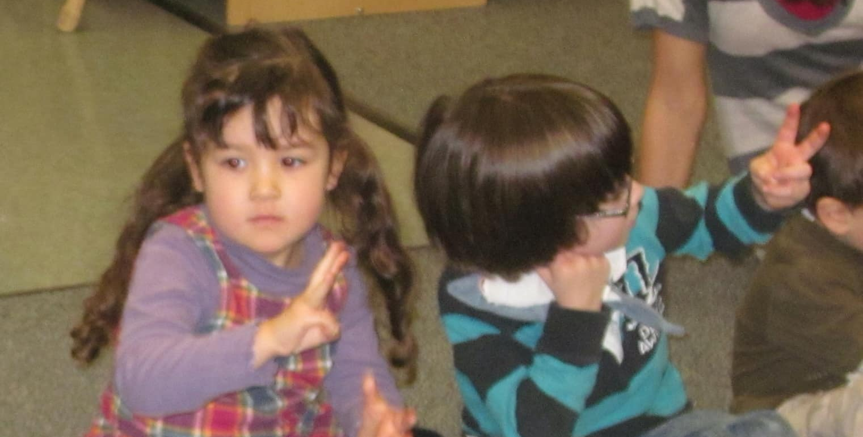

Composer to 5 or 10 games
Up and down
Bunny ears
Sneaky snake
10 frames

Slide 24
EYFS ELGs
The EYFS mathematics Early Learning Goals (ELGs) for the end of Reception focus on two key areas: Number and Numerical Patterns. Children are expected to have a deep understanding of numbers to 10, including composition, subitising up to 5, and automatic recall of number bonds to 5 and some to 10, alongside counting beyond 20, comparing quantities, and exploring numerical patterns.

Slide 25
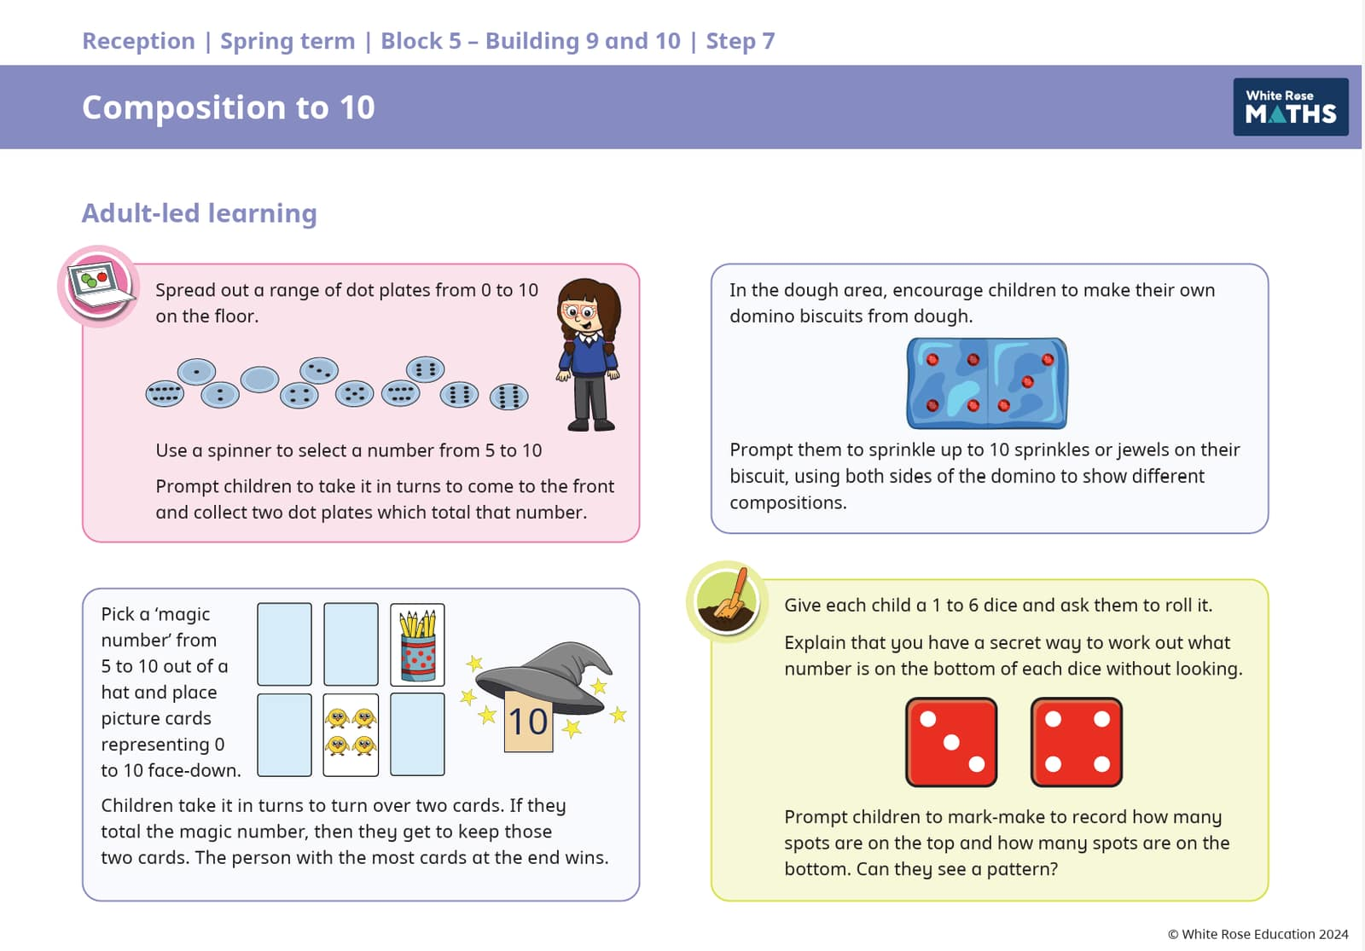
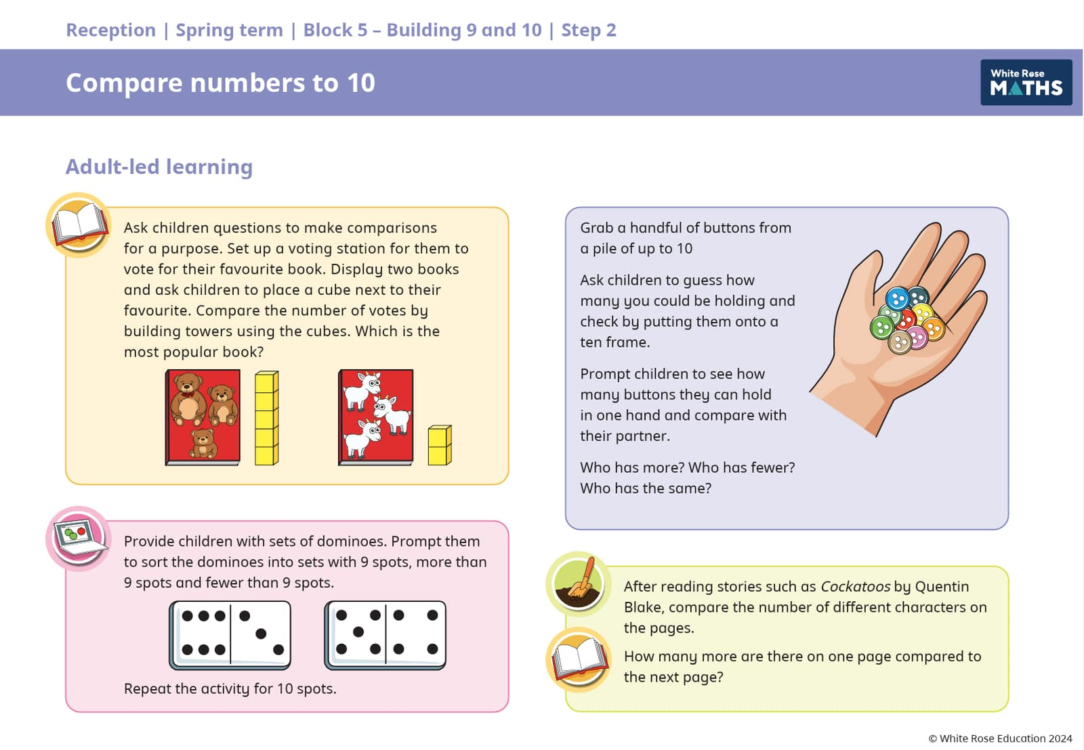

Slide 26
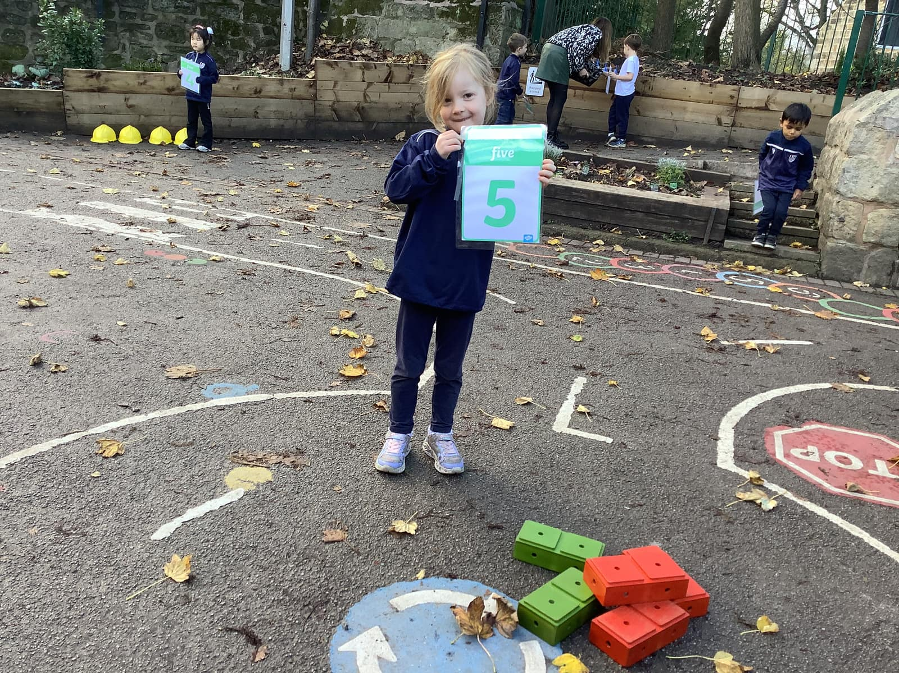
Questions...

